Slide 1
ASU ASCEND
By
Mason Denney

Slide 2
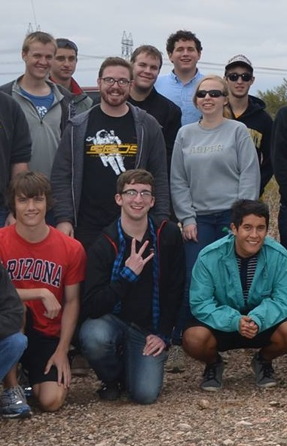
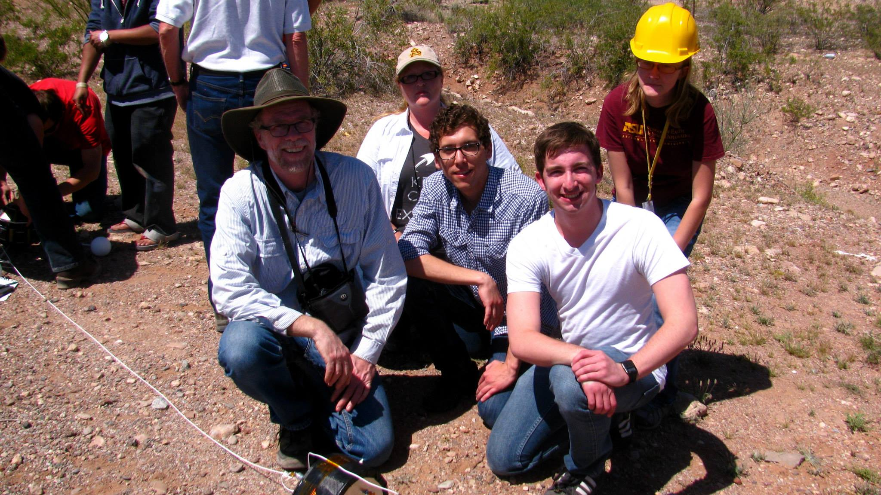
The Team

Slide 3
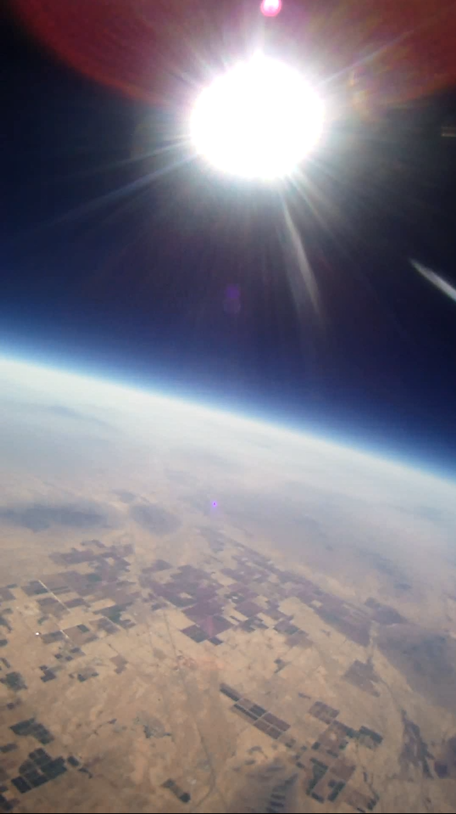
Past Flights
Last Spring
  Captured flight footage with
  Hack HD, but no sensor data
Last Fall
  Excellent data from sensors,
  but no video

Slide 4
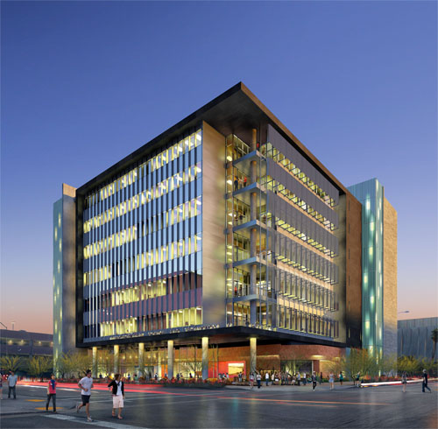
New Objectives
360 Panorama
  Outreach at ISTB4
Environmental data

Slide 5

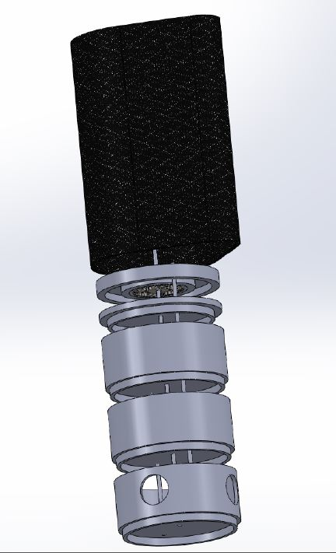
New Fuselage
Wind Stabilization
Unobstructed Panorama
  Utilize Blind Spots
Dependable Materials
  Carbon Fiber

Slide 6

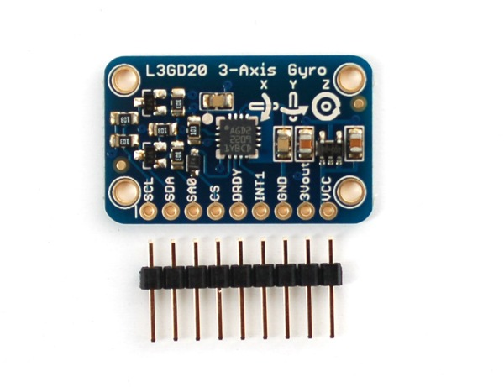
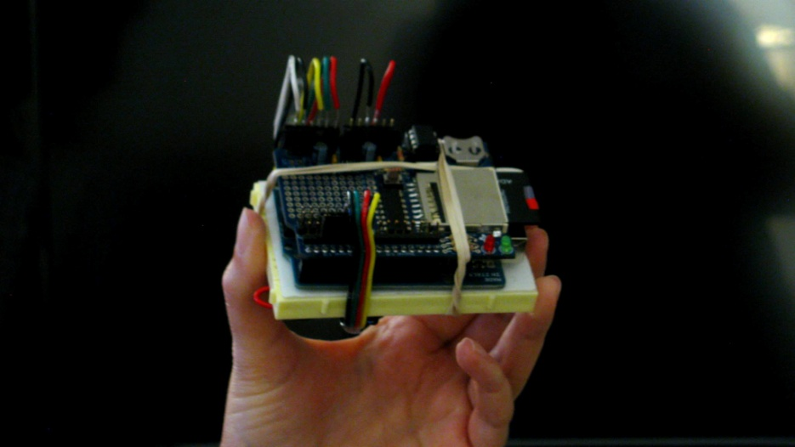
Sensors
Barometer
  Altitude
  Temperature
  Air Pressure
Accelerometer
Gyroscope

Slide 7
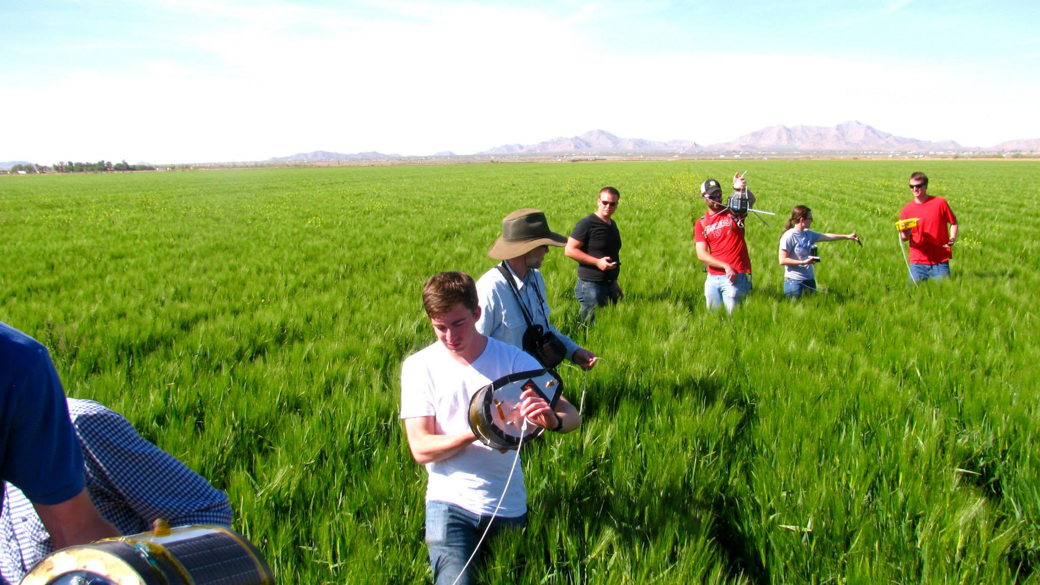
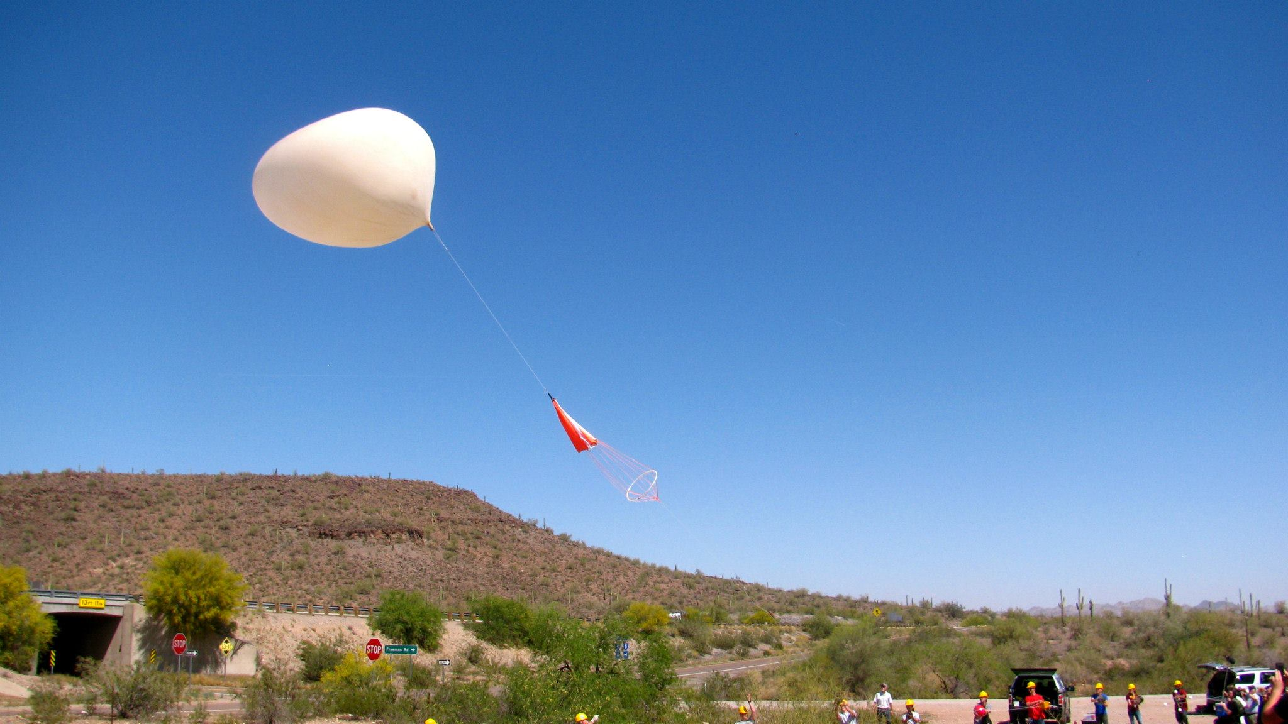
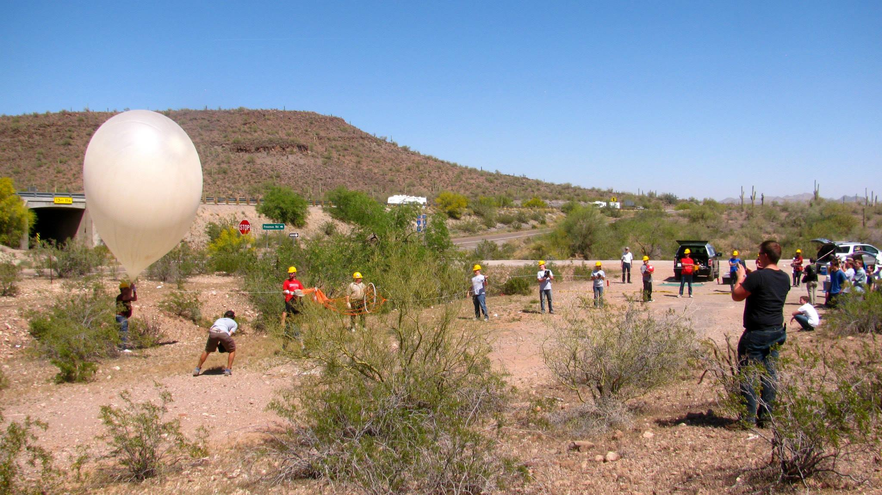
Lift Off and Recovery

Slide 8
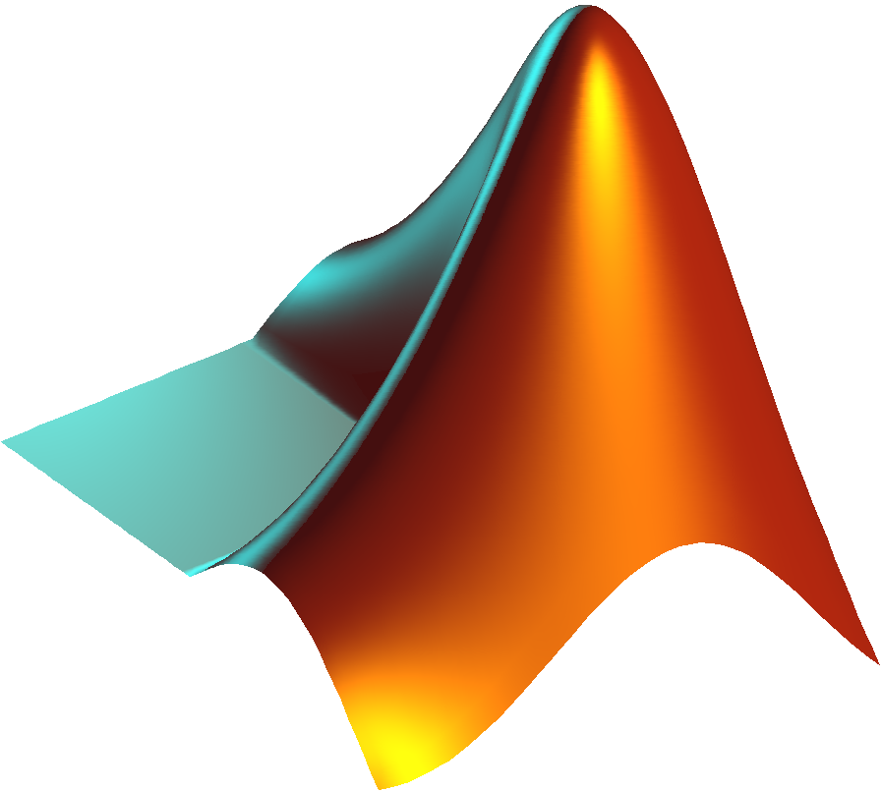
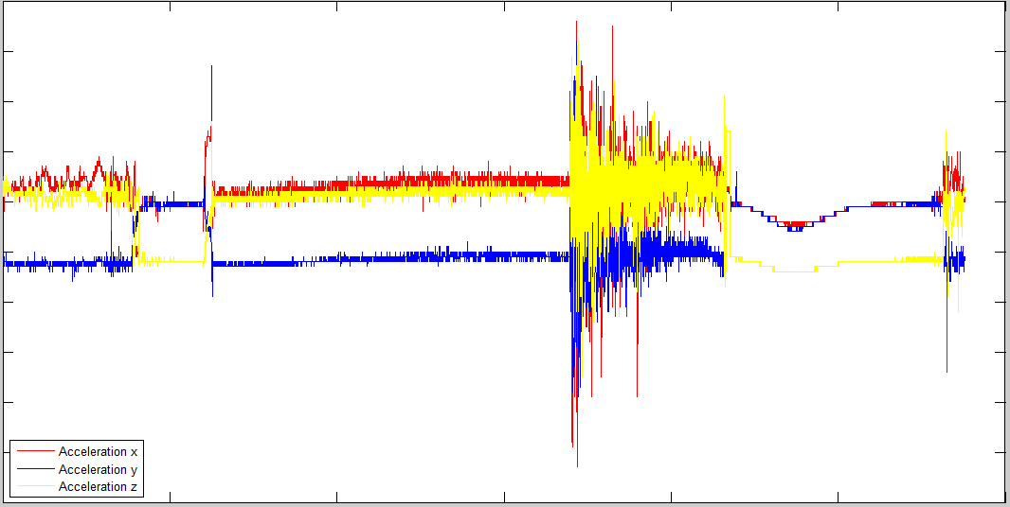
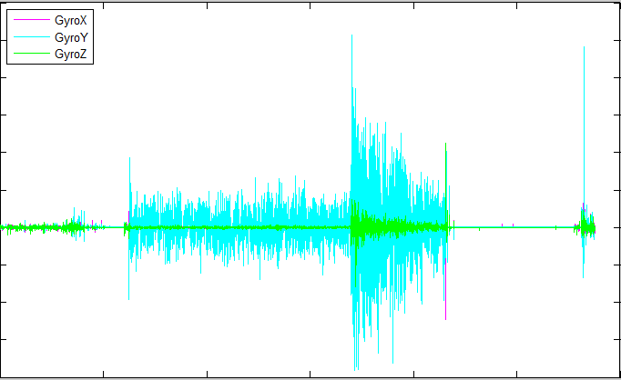
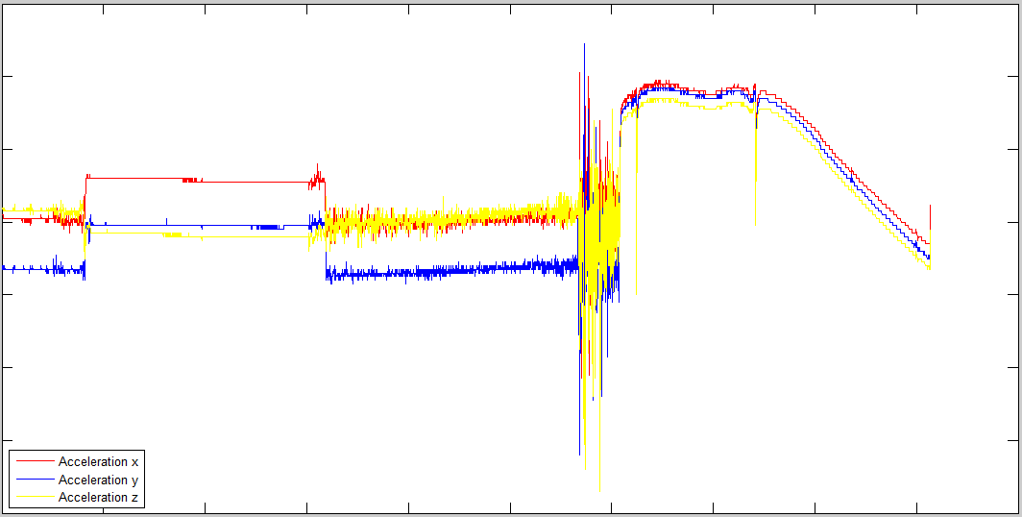
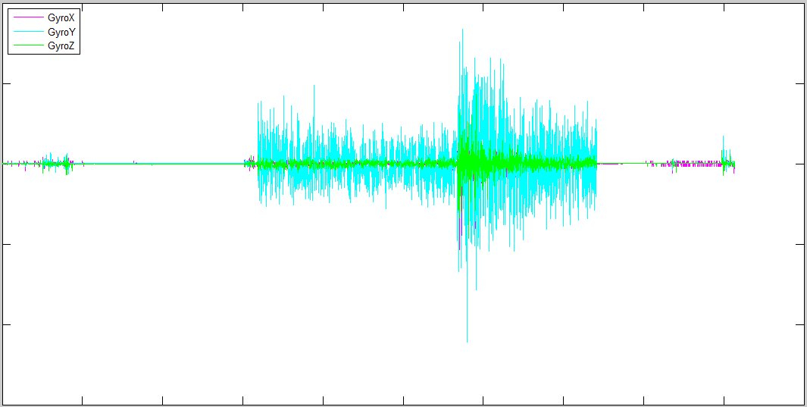
Data Processing-Accelerometer
with
MATLAB
We will strive to dampen shock faster through better design.
Fall 2013
Spring 2014

Slide 9
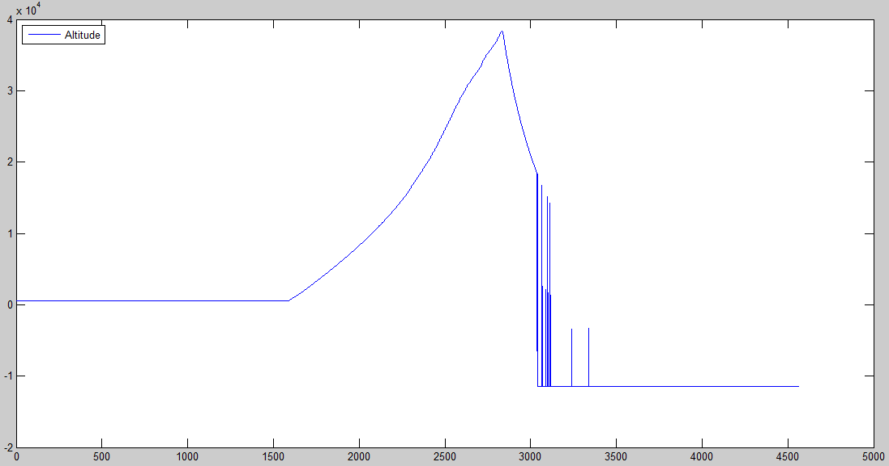
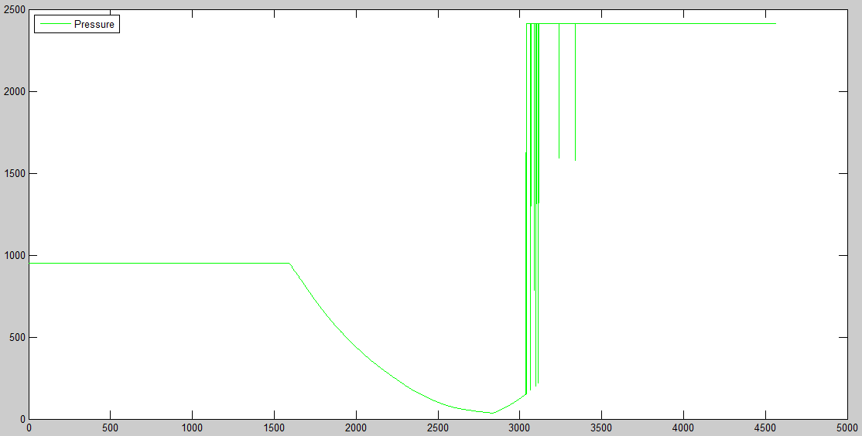
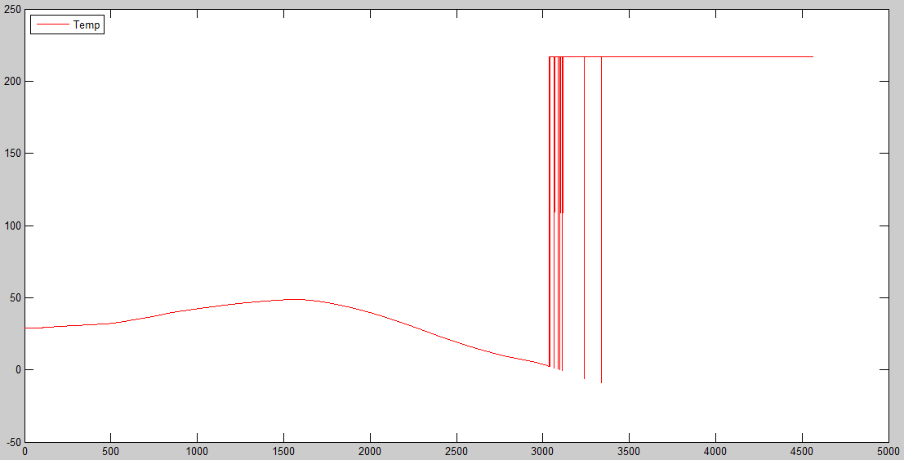
Environmental Sensors
Perfect until 50 min 36sec into flight
No surprises in the environmental data

Slide 10
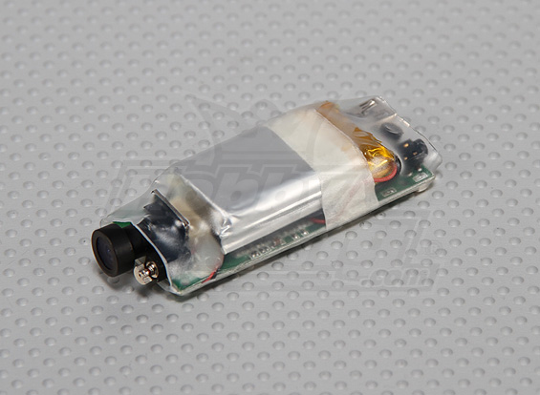
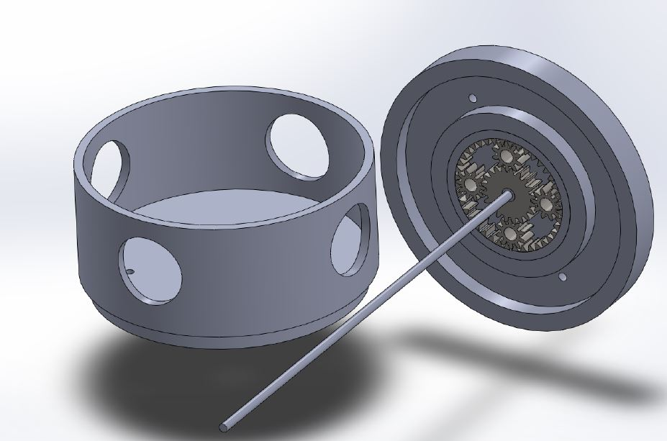
Conclusion and Lessons Learned
Need to replace cameras
  New Fuselage
Root the out cause of
barometer failure
HD Wing Camera
Similar conditions and response the past 2 flights
Use data in the planetary gear design

